Slide 1


A Purposeful Walk Down Wallstreet
Michael Shields, Nabeel Asghar, Shojib Miah, Michael Chen

Slide 2
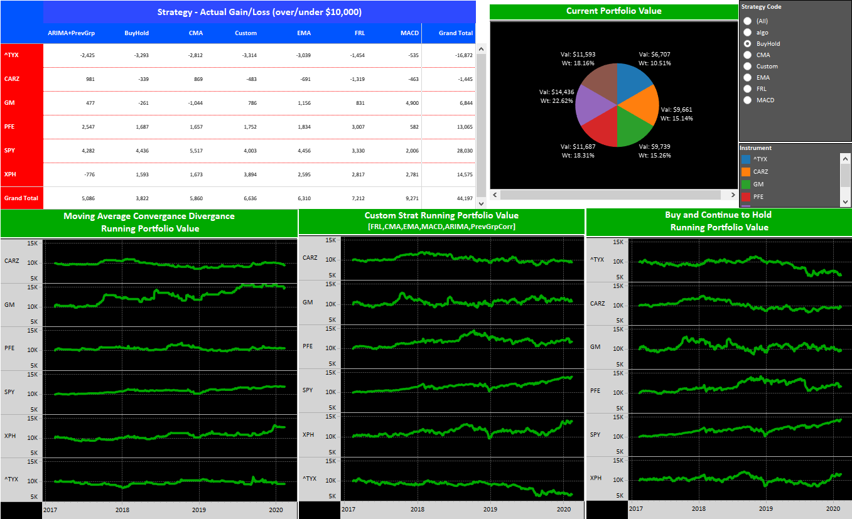

Product Perspective

Slide 3
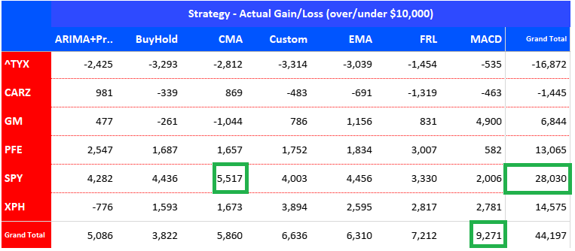
Product Perspective Cont.

Slide 4
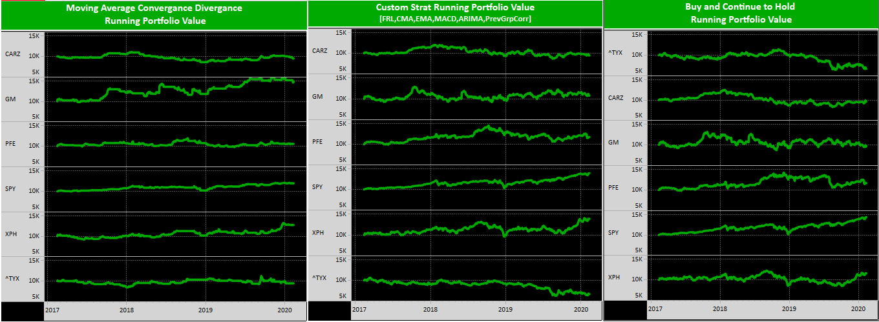
Product Perspective Continued

Slide 5
Product Functions
Client Selected Stocks/Indexes Automotive Pharmaceuticals S&P 500 Treasury Bonds
Macroeconomic Variables GDP Misery Index Inflation Rate Unemployment Rate Stock Market Confidence Consumer Price Index Treasury Bonds
Notes:
Macroeconomic Variables
GDP
Misery Index
Inflation Rate
Unemployment Rate
Stock Market Confidence Index
Consumer Price Index
Treasury Bonds

Slide 6
General Constraints
Internet connection
Access to a free trading data exchange

Slide 7
Assumptions & Dependencies
PyCharm or other Python IDE
Python and Python libraries
Tableau: 2018 or later
Database: MySQL Workbench 8.0 or later

Slide 8



FR 1 – Storing Data into MySQL
ID | FR_1.0
Name | Store macro variables into the database
Description | Store inflation rate, unemployment rate, misery index, GDP, NPGDP, Stock market confidence index, consumer price index, and US stock price data into the database.
Rationale | Stores essential variables needed for the project into database
Input | Data received from Quandl and Yahoo datasets using pandas dataframe data structure to store and send to the database
Output | Stored macroeconomic and stock variables into the database
Forward Dependency | None
Backward Dependency | Quandl and Yahoo datasets
Priority | High | Priority Reason | Large Scale
Priority Sequence | H-2
Error Handling | Users will have to analyze data in the MySQL Workbench to debug if data is accurately taken from Yahoo and Quandl’s APIs.

Slide 9
FR 2 – Data Analyzed in Python
ID | FR_2.0
Name | Analyze the results of the data and put them into our database
Description | Using data stored in our MySQL database that has data from YAHOO Finance and Quandl, we analyze this data and calculate buy and sell points and predict prices.
Rationale | Analyze data and store them into our MySQL database
Input | Data received from Quandl and YAHOO Finance datasets using pandas dataframe data structure to store and send to the database
Output | Stored data into the database
Forward Dependency | None
Backward Dependency | MySQL Database and Python
Priority | High | Priority Reason | Large Scale
Priority Sequence | H-2
Error Handling | User will have to analyze code to determine if there are any errors in it and analyze the MySQL Database to see if any issues are there.
Notes:
Data is taken using SQL queries
Analyzed for price forecasts
Manipulated to calculate buy and sell signals
Stored back into MySQL Database

Slide 10
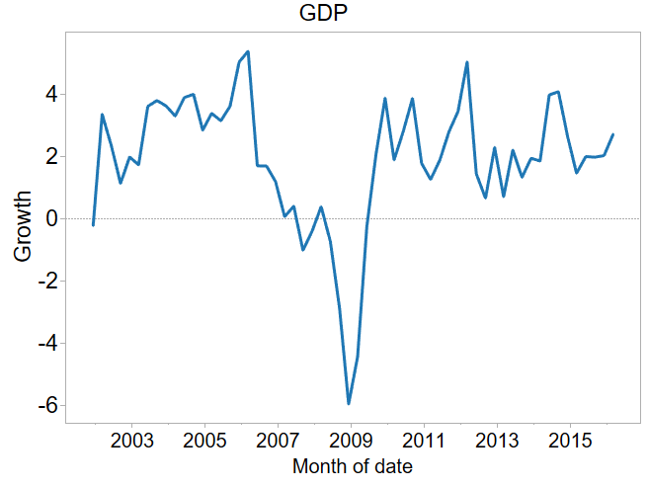
FR 3 – Data Displayed in Tableau
Name | Tableau shows various graphs without a name using macroeconomic variables and machine learning algorithms
Description | Along the bottom of the Tableau dashboard, the graphs titles for the pricing data collected for various graphs will be displayed. The labels will also indicate which algorithm each of them will show, and which variables are instilled within the graph.
Rationale | The user will be able to view the predictions of the algorithm of their choice by selecting the corresponding tab along the bottom of the Tableau Dashboard.
Input | Data from database tables
Output | Front End Tableau user interface
Forward Dependency | None
Backward Dependency | FR_3.0
Priority | Medium | Priority Reason | Low Scale
Priority Sequence | M-2
Error Handling | Data table or calculations will need to be reviewed. Tableau visual could also have an issue. User can manipulate the front-end by changing visual settings or values. If error is still not resolved a developer will need to review.

Slide 11
NFR 1 – Data Sources
ID | NFR_2.0
Name | Data Sources
Description | Updating the data when the application is launched automatically
Rationale | When the application starts the system should pull data from YAHOO and display it via Tableau. To keep the data current and ensure business standards are met, the data and visualizations will be current to the day. Data load time must be optimized to not take any longer than 1-3 minutes.
Input | Data from configured data sources, database management system
Output | Auto refresh of the application
Forward Dependency | All NFRs
Backward Dependency | None
Priority | High
Priority Sequence | H-2

Slide 12
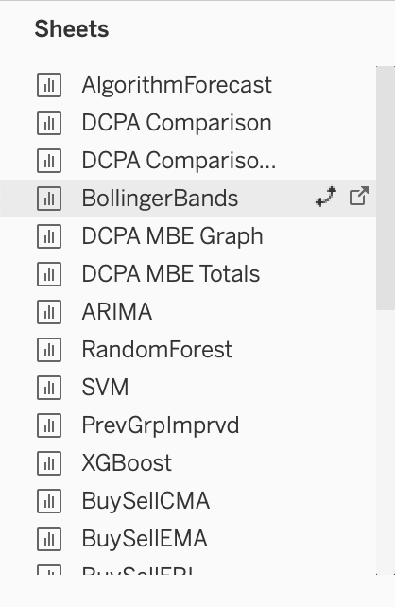
NFR 2 – Graphs and Visualizations
ID | NFR_3.0
Name | Graphs & Visualizations
Description | Although the graphs are already easier to interpret, the color must be switched from black to white for a cleaner look as per the client. The graphs must clearly show a distinction between those that are using macroeconomic variables and those that are not. The user should be able to view individual graphs and measurements. Information related to each graph i.e. legend, info box, sheets, strategy codes should be displayed clearly.
Rationale | For the user to have full comprehension of the data being displayed it is necessary that there is nothing ambiguous on the user interface
Input | Data from the data-sources, Tableau canvas and tabs
Output | Graphs display
Forward Dependency | None
Backward Dependency | None
Priority | High
Priority Sequence | H-3

Slide 13
NFR 3 – Dual Graphs (Dashboard)
ID | NFR_4.0
Name | Dual Graphs
Description | The two graphs on the data source trade charts will show how the previous algorithm is progressing and the other one will show how the new algorithm with macroeconomic variables will be progressing over a 100-day period.
Rationale | To visually represent how the two algorithms, buy and sell and to visualize how that volumetric trading is outperforming the “all in” strategy.
Input | Data from the data-sources configured in Tableau and Quandl
Output | Graphs with 2 or more lines and measures in the user interface of Tableau
Forward Dependency | None
Backward Dependency | None
Priority | Medium
Priority Sequence | M-1

Slide 14
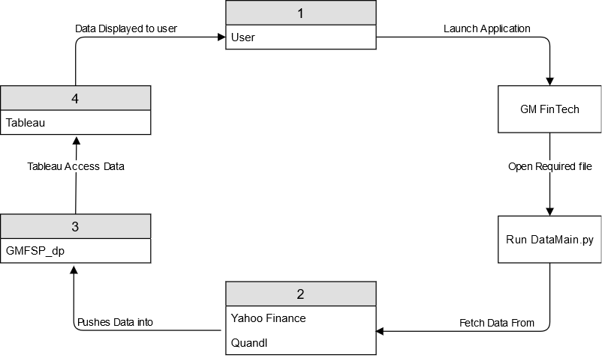
Data Flow Diagram

Slide 15
Design Constraints
Database structure is setup per client's requirements
Database set up to run on MySQL
Python 3.6 or later must be used for back-end code execution
Dependent libraries must be installed before code execution
GitLab/GitHub used for the latest version of code
Tableau Software and services used for user interface
Steady internet connection to update Yahoo and Quandl Data

